Slide 1
Experience Expo
By
Satya Shodhaka R Prabhanjan

Slide 2
Introduction
1.

Slide 3
Introduction
Sharing experiences with ease proves to be a problem.
There is a need for a platform where people can share their experiences.
These experiences are much needed for young minds to grow mentally and get inspired.

Slide 4
The Problem
2.

Slide 5
The problem
There are no much platforms where people are free to share their technical experiences.
The juniors in college are much required to be educated about the interview culture.

Slide 6
Existing
3.

Slide 7
Existing
There are very few platforms which allows the users to talk about their work and interview experiences.
Although these platforms majorly speak keeping people of different age groups in mind.

Slide 8
Our Approach
4.

Slide 9
Our Approach
The aim of this project is to develop a platform which allows the college alumni and seniors to talk about their real life experiences.
This information is significant for the juniors to kick start their career.
Also Visualizing the data helps the students to build up their skill set.

Slide 10
Features
5.

Slide 11
Features
Allows the Users to sign up and create a personal profile with their details.
They get to add their skill set for the data visualization.
Write about their personal work culture experiences.

Slide 12
Technologies
6.

Slide 13
Technologies
The application is built on the Django framework, a high-level
python based Web Framework.
HTML was used to build the skeleton on the web pages.
CSS was used to style the pages to make them more user-friendly.
JavaScript was used to make the pages functional.

Slide 14
Design and Snippets
7.

Slide 15
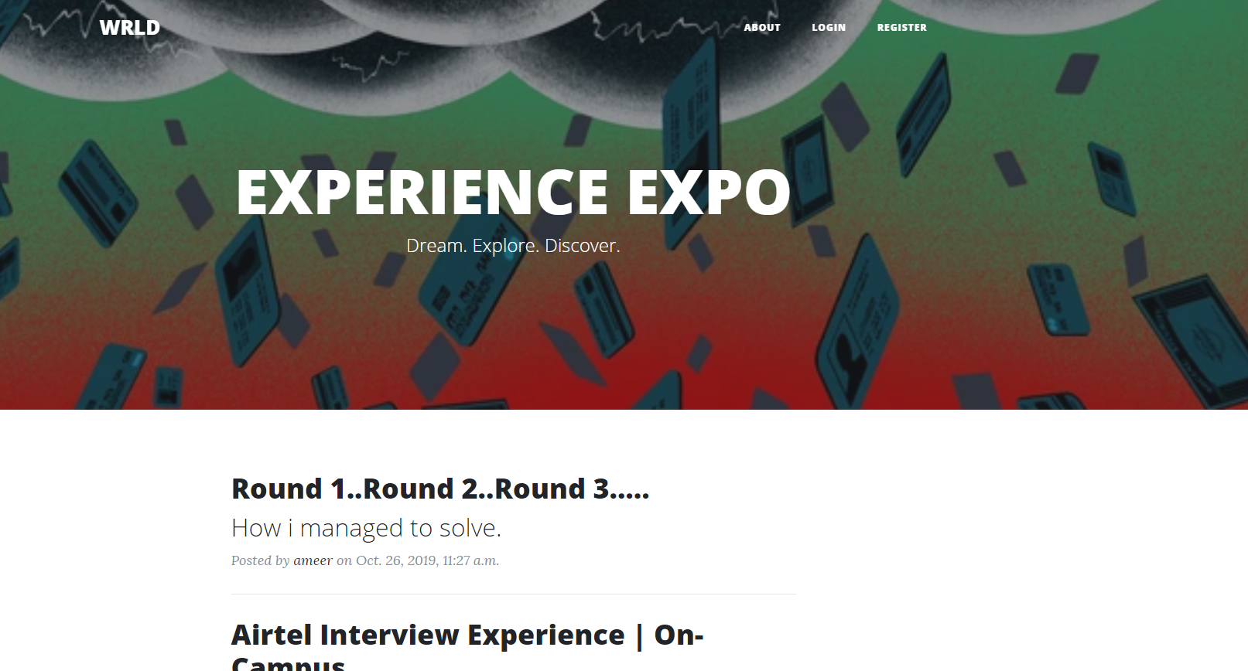
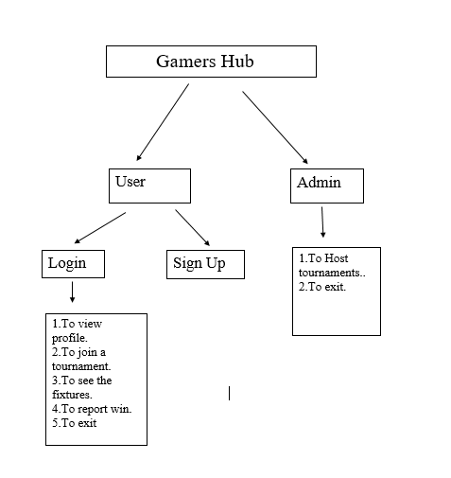

Slide 16
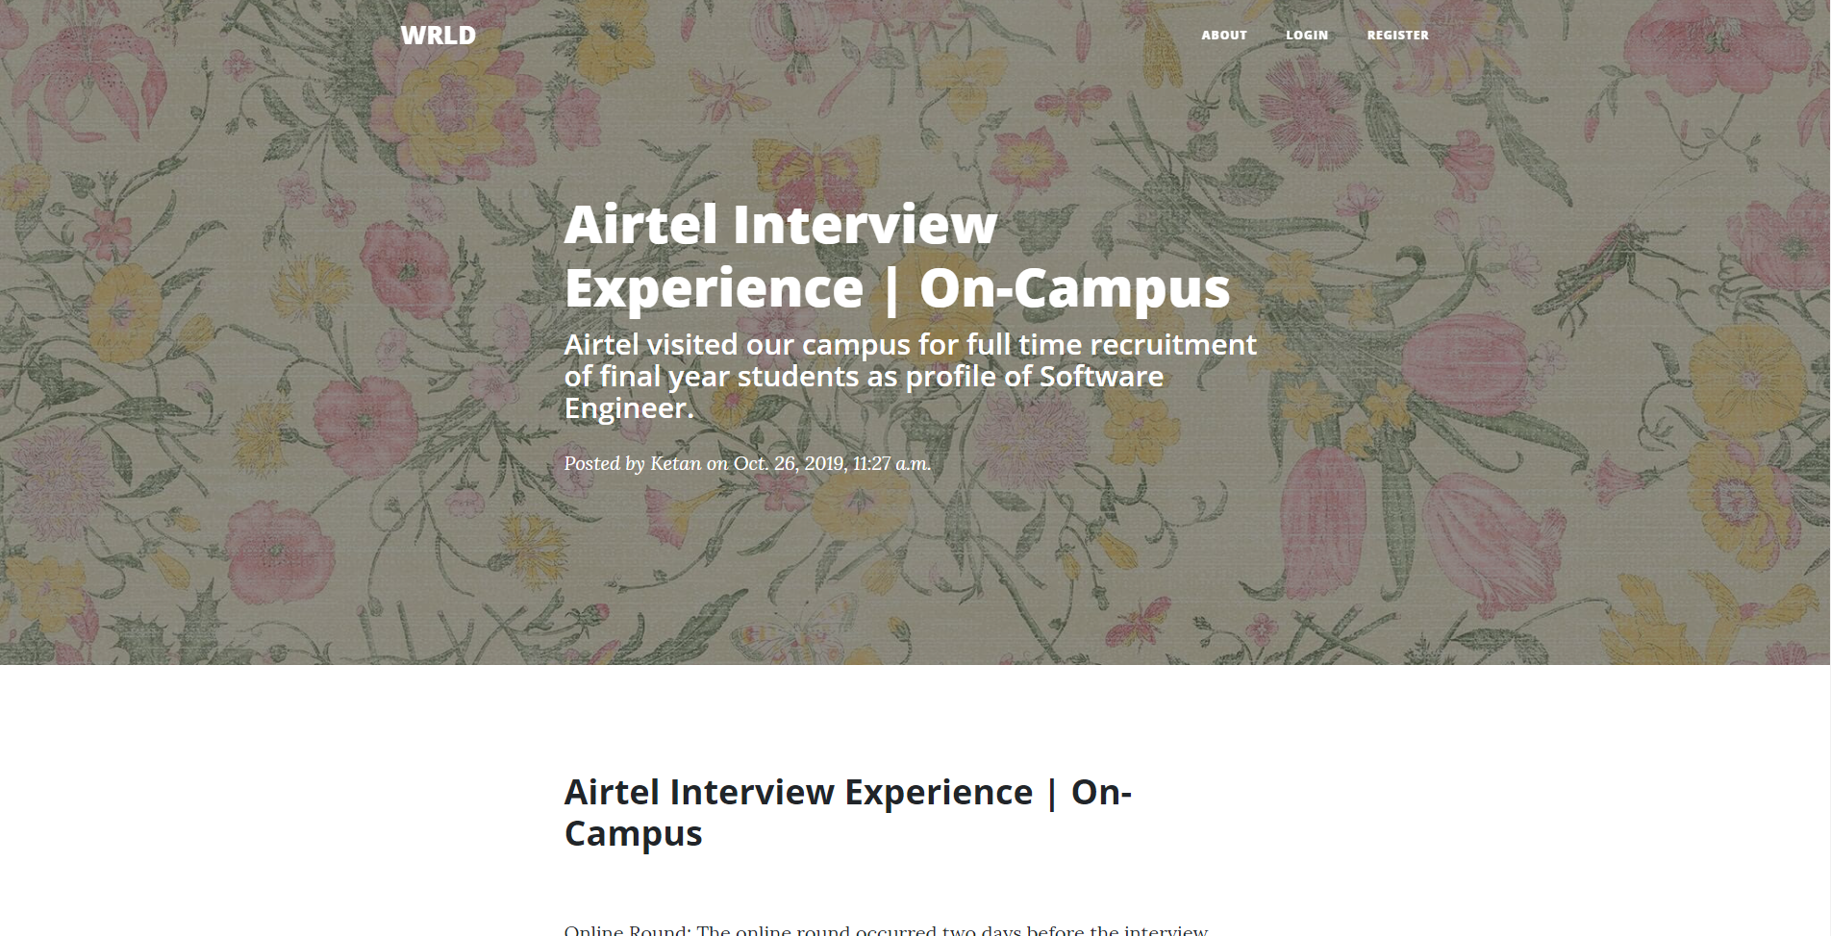
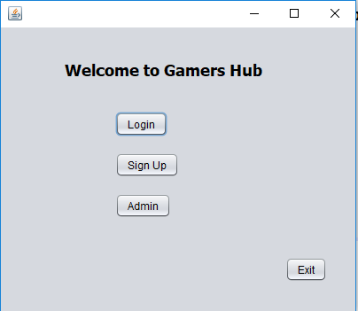

Slide 17
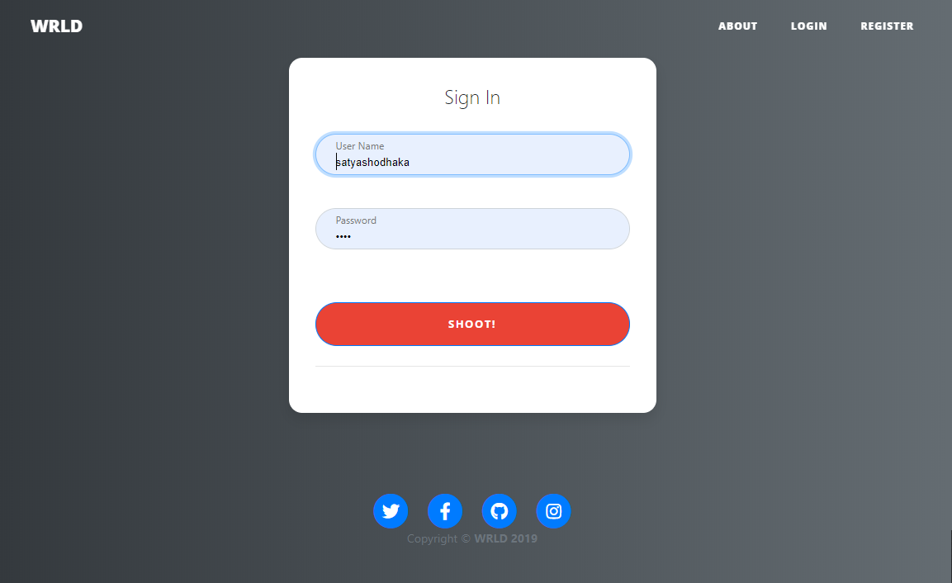
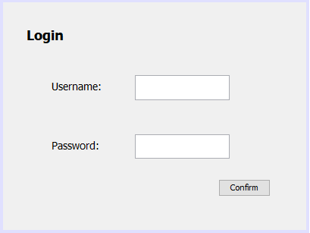

Slide 18
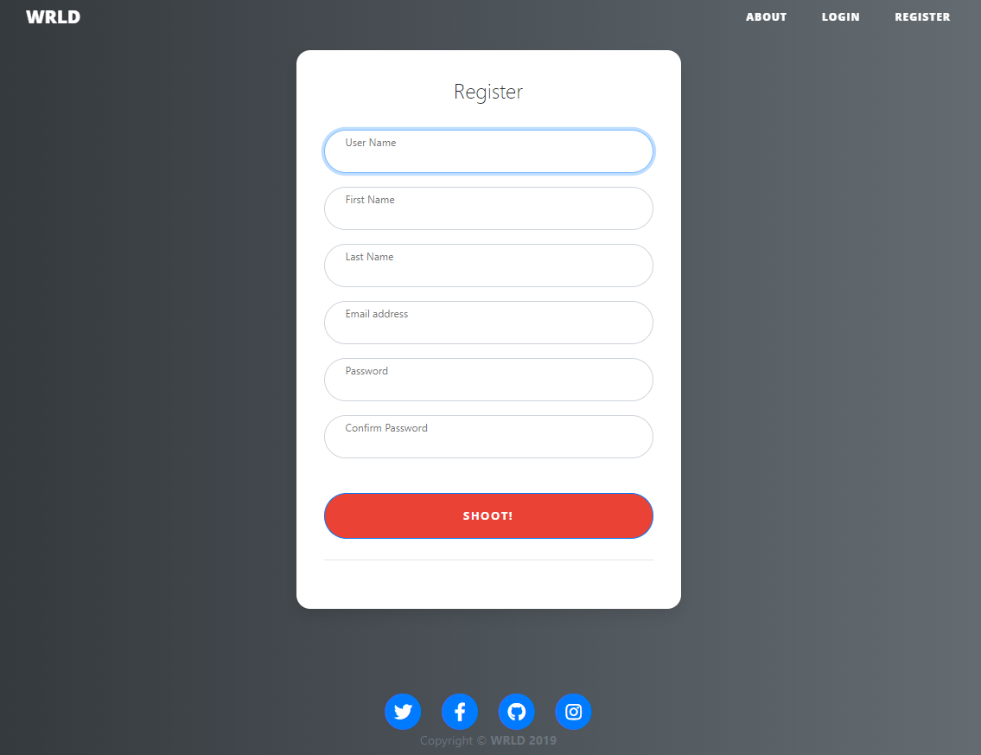
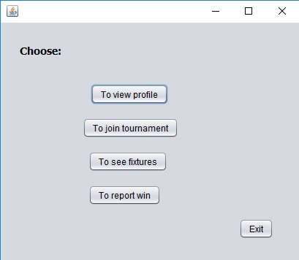

Slide 19


Slide 20
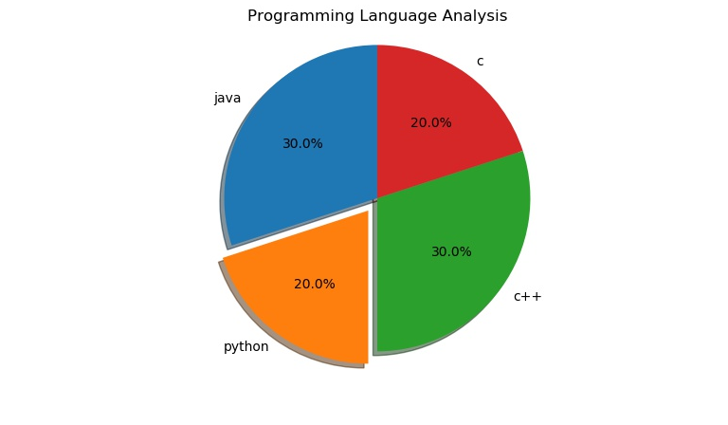

Slide 21
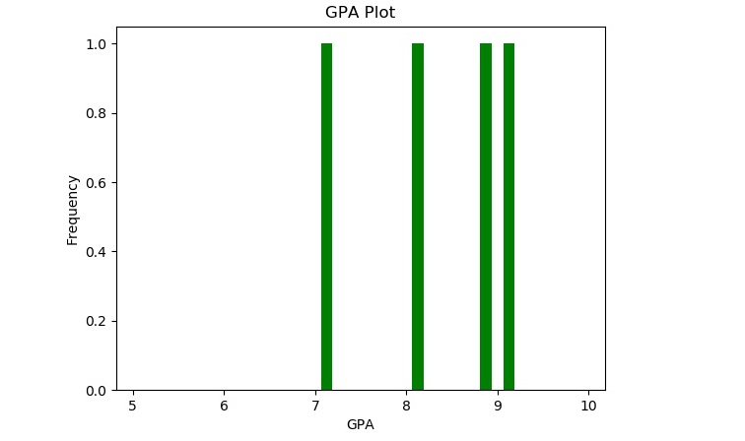

Slide 22
Conclusion
8.

Slide 23
Conclusion
Our project is made in order to educate the students with the real world experiences
Students would feel much confident after exposed to the success stories.
The students with this would have a clear idea about how the interviews are being conducted.
Students can Subscribe to the Newsletter for latest updates.
This platform would help the students to explore their interests and work on them.

Slide 24
Any queries?

Slide 25
Thanks!

Slide 27
Quotations are commonly printed as a means of inspiration and to invoke philosophical thoughts from the reader.

Slide 28
This is a slide title
Here you have a list of items
And some text
But remember not to overload your slides with content
Your audience will listen to you or read the content, but won’t do both.

Slide 32
You can also split your content
White
Is the color of milk and fresh snow, the color produced by the combination of all the colors of the visible spectrum.
Black
Is the color of coal, ebony, and of outer space. It is the darkest color, the result of the absence of or complete absorption of light.

Slide 33
In two or three columns
Yellow
Is the color of gold, butter and ripe lemons. In the spectrum of visible light, yellow is found between green and orange.
Blue
Is the colour of the clear sky and the deep sea. It is located between violet and green on the optical spectrum.
Red
Is the color of blood, and because of this it has historically been associated with sacrifice, danger and courage.

Slide 34
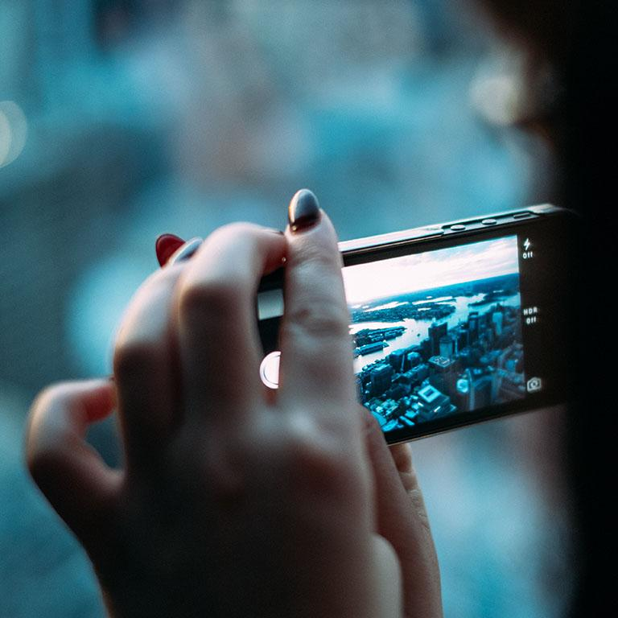
A picture is worth a thousand words
A complex idea can be conveyed with just a single still image, namely making it possible to absorb large amounts of data quickly.

Slide 35
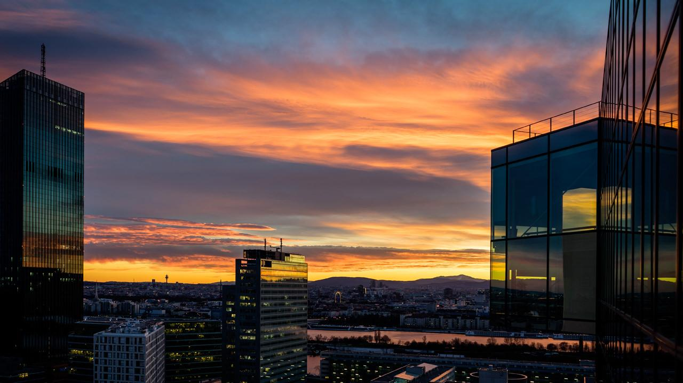
Want big impact?
Use big image.

Slide 36
Use charts to explain your ideas
Gray
White
Black

Slide 37
And tables to compare data
 | A | B | C
Yellow | 10 | 20 | 7
Blue | 30 | 15 | 10
Orange | 5 | 24 | 16

Slide 38
Maps
our office

Slide 39
89,526,124
Whoa! That’s a big number, aren’t you proud?

Slide 40
89,526,124$
185,244 users
100%
That’s a lot of money
And a lot of users
Total success!

Slide 41
Our process is easy
first
second
last

Slide 42
Let’s review some concepts
Yellow
Is the color of gold, butter and ripe lemons. In the spectrum of visible light, yellow is found between green and orange.
Blue
Is the colour of the clear sky and the deep sea. It is located between violet and green on the optical spectrum.
Red
Is the color of blood, and because of this it has historically been associated with sacrifice, danger and courage.
Yellow
Is the color of gold, butter and ripe lemons. In the spectrum of visible light, yellow is found between green and orange.
Blue
Is the colour of the clear sky and the deep sea. It is located between violet and green on the optical spectrum.
Red
Is the color of blood, and because of this it has historically been associated with sacrifice, danger and courage.

Slide 43
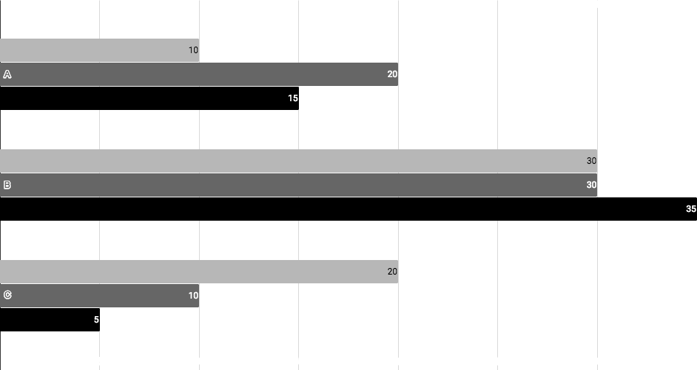
You can insert graphs from Google Sheets

Slide 44
Android project
Show and explain your web, app or software projects using these gadget templates.
Place your screenshot here

Slide 45
iPhone project
Show and explain your web, app or software projects using these gadget templates.
Place your screenshot here

Slide 46
Tablet project
Show and explain your web, app or software projects using these gadget templates.
Place your screenshot here

Slide 47
Desktop project
Show and explain your web, app or software projects using these gadget templates.
Place your screenshot here

Slide 48
Credits
Special thanks to all the people who made and released these awesome resources for free:
Presentation template by SlidesCarnival
Photographs by Unsplash

Slide 49
Presentation design
This presentation uses the following typographies:
Titles: Work sans bold
Body copy: Work sans light
You can download the fonts on this page:
https://github.com/weiweihuanghuang/Work-Sans/tree/master/fonts/desktop
You don’t need to keep this slide in your presentation. It’s only here to serve you as a design guide if you need to create new slides or download the fonts to edit the presentation in PowerPoint®

Slide 50
SlidesCarnival icons are editable shapes.
This means that you can:
Resize them without losing quality.
Change fill color and opacity.
Change line color, width and style.
Isn’t that nice? :)
Examples:

Slide 51
😉
Now you can use any emoji as an icon!
And of course it resizes without losing quality and you can change the color.
How? Follow Google instructions https://twitter.com/googledocs/status/730087240156643328
✋👆👉👍👤👦👧👨👩👪💃🏃💑❤😂😉😋😒😭👶😸🐟🍒🍔💣📌📖🔨🎃🎈🎨🏈🏰🌏🔌🔑 and many more...

